Slide 1
File Handling, JDBC & SQL in Java
By: Arpit Bhushan Sharma
Mentor ProPeers

Slide 2
File Handling, JDBC & SQL in Java
Introduction: File Handling & Database Integration in Java
Basics of File Handling in Java
Character Streams: FileReader & FileWriter
Buffered Streams: BufferedReader & BufferedWriter
Practical Demo: Reading & Writing Text Files
Introduction to JDBC: Bridging Java and Databases
JDBC Architecture: Components and Flow
Connecting Java with MySQL Database
Performing CRUD Operations with JDBC (Part 1)
Performing CRUD Operations with JDBC (Part 2)

Slide 3
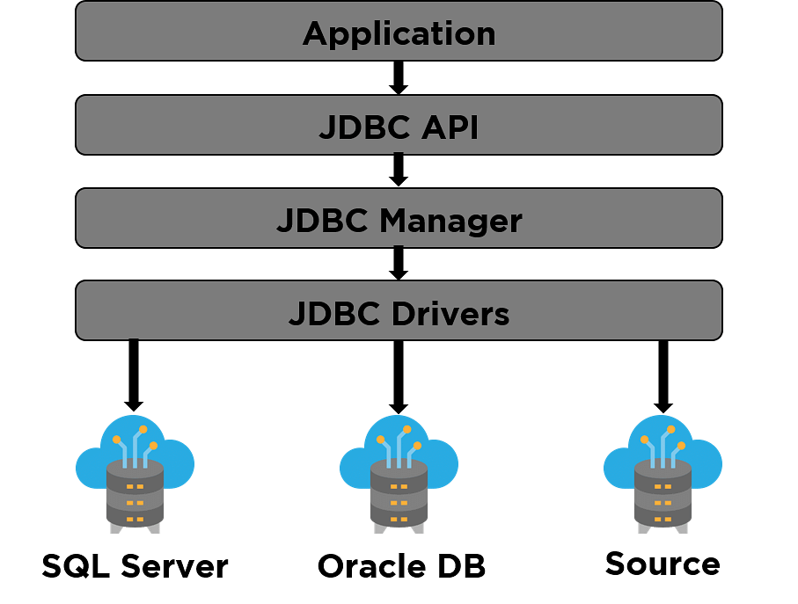
Introduction: File Handling & Database Integration in Java
Importance: Crucial for persistent data storage and dynamic application interaction.
File Handling: Essential for logging, configuration, temporary data storage, and reading/writing simple text or binary files.
Database Integration (JDBC & SQL): Vital for managing structured, large-scale data, ensuring data integrity, security, and concurrent access in complex applications.

Slide 4
Basics of File Handling in Java
What is File Handling?
File Handling in Java refers to the process of reading from and writing data to files on a computer's storage.
It allows Java applications to interact with the file system, enabling them to store and retrieve information persistently, even after the program terminates.

Slide 5
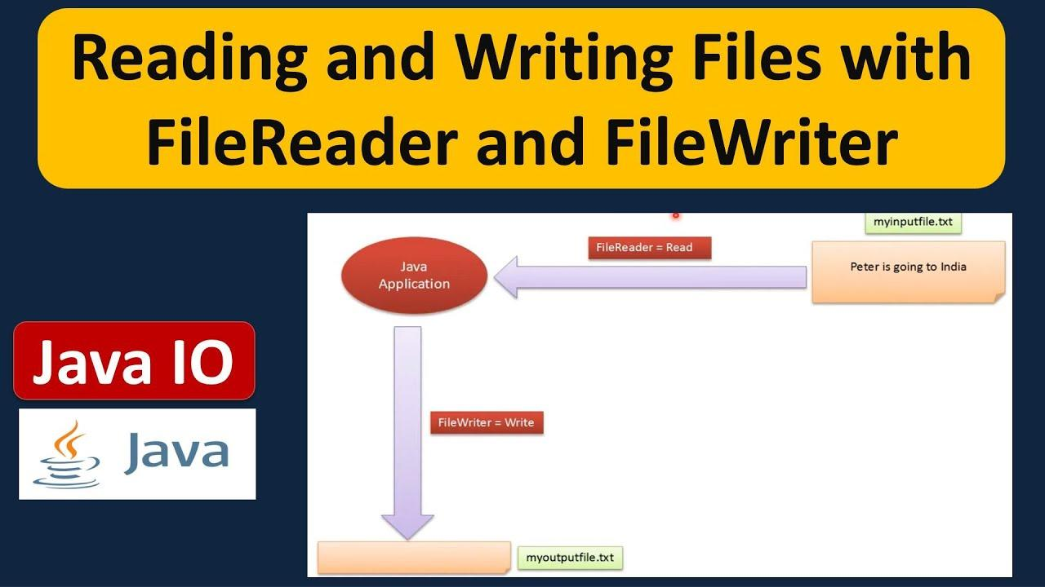
Character Streams: FileReader & FileWriter
FileReader: Used for reading character streams from files. It's suitable for text files.
FileWriter: Used for writing character streams to files. It's suitable for writing text data.
Syntax (Conceptual):

Slide 6
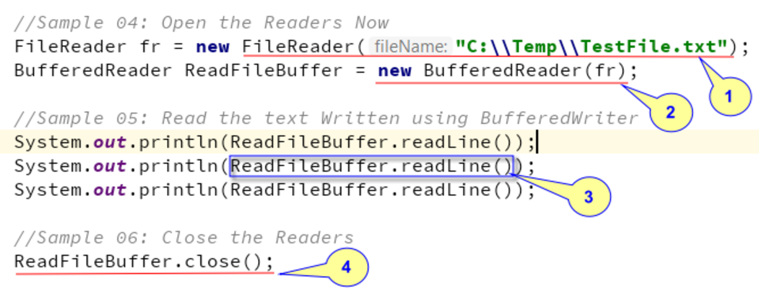
Buffered Streams: BufferedReader & BufferedWriter
Why Buffering is Needed (Efficiency):
FileReader and FileWriter read/write one character at a time, which can be inefficient for large files due to frequent disk I/O operations.
BufferedReader and BufferedWriter add a buffer layer, reading/writing larger blocks of data at once, significantly reducing physical disk accesses and improving performance.

Slide 7
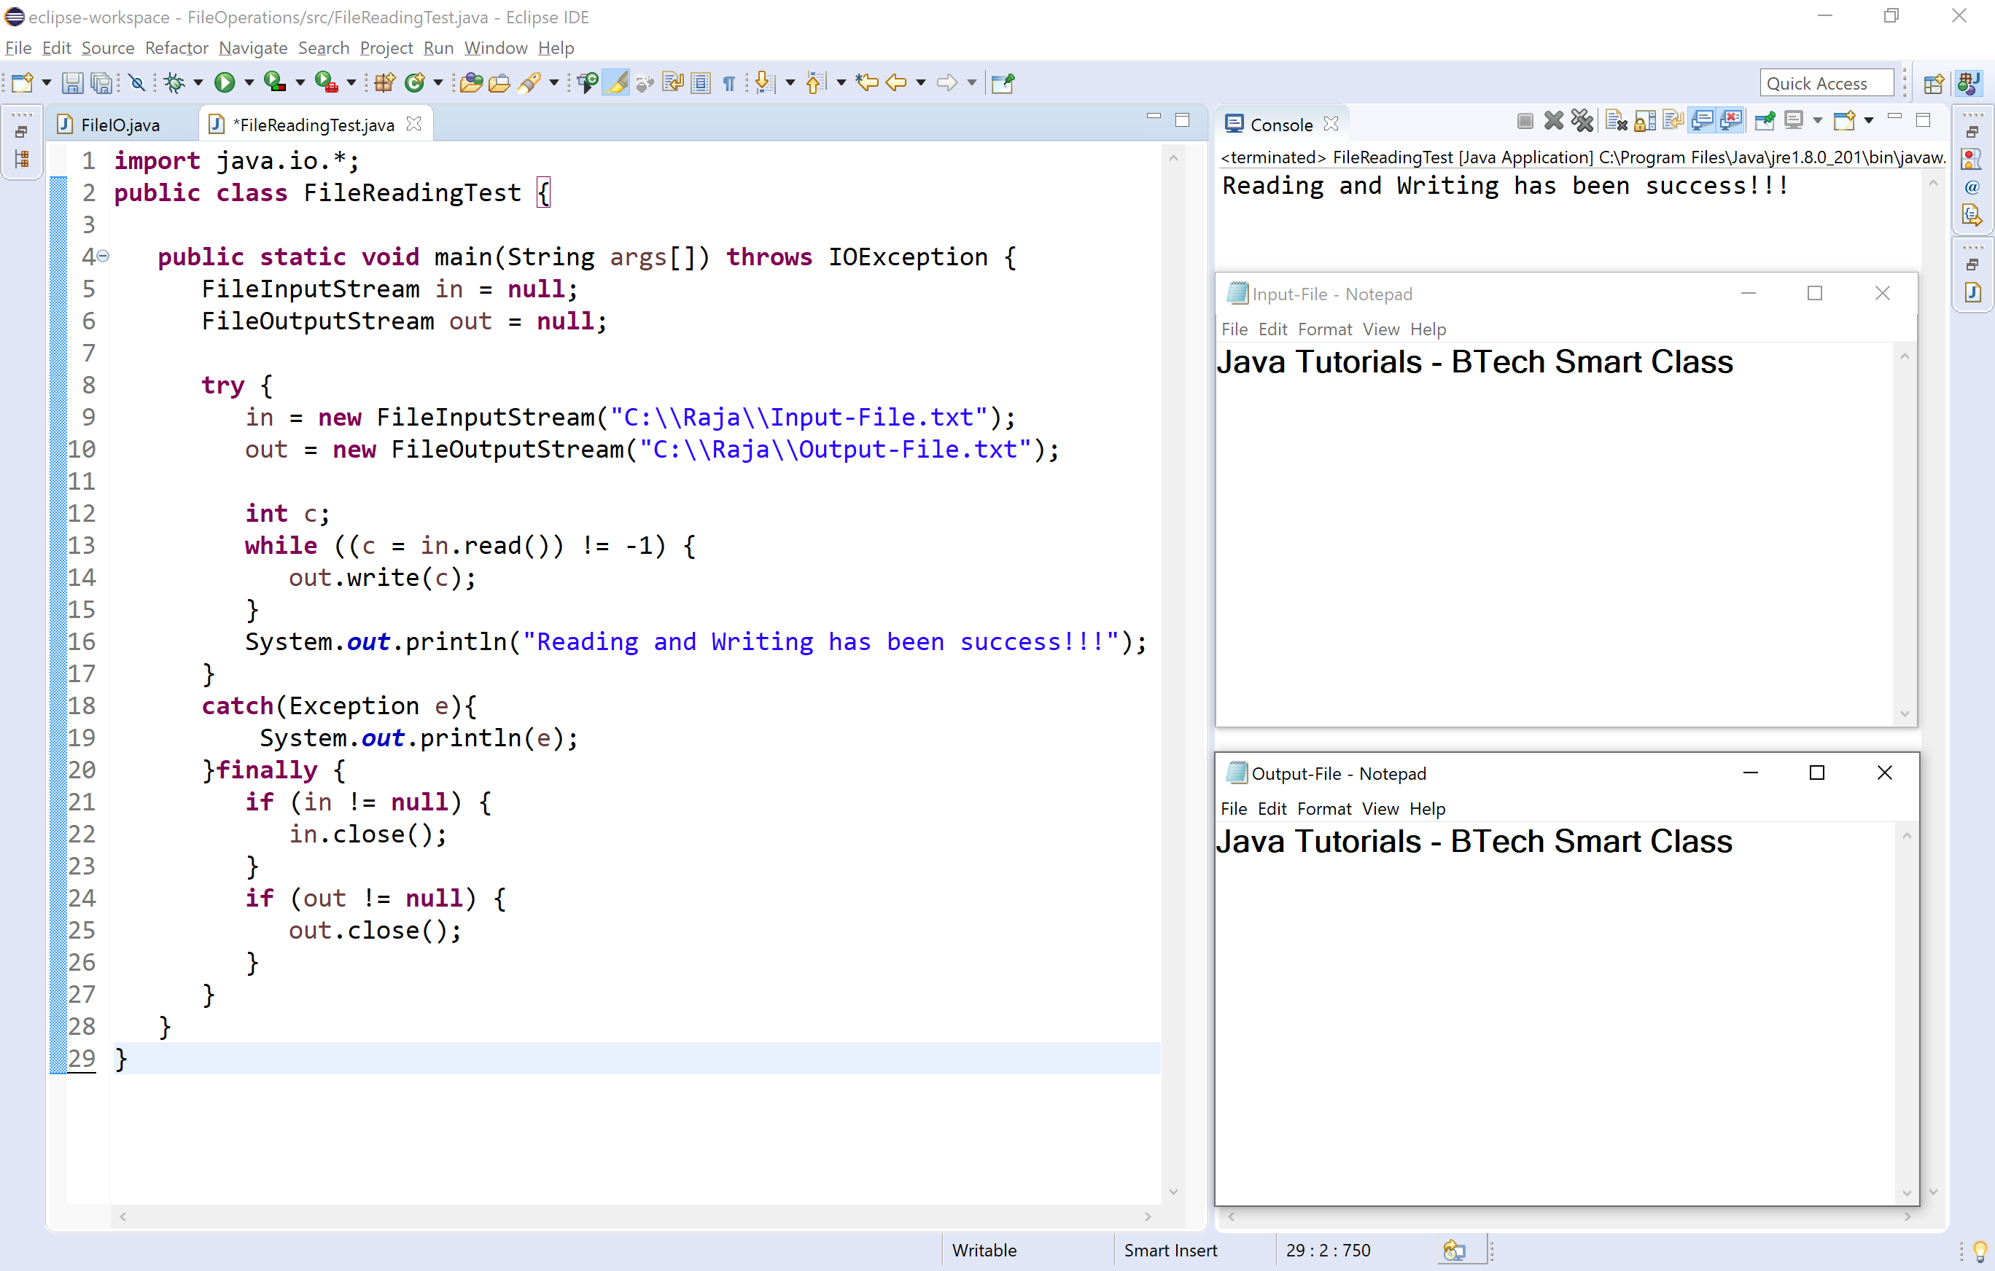
Practical Demo: Reading & Writing Text Files
Sample Code: Reading from a text file, processing data, and writing to another file.
Scenario: Read numbers from 'numbers.txt', square them, and write results to 'squared_numbers.txt'.
`numbers.txt` content:

Slide 8
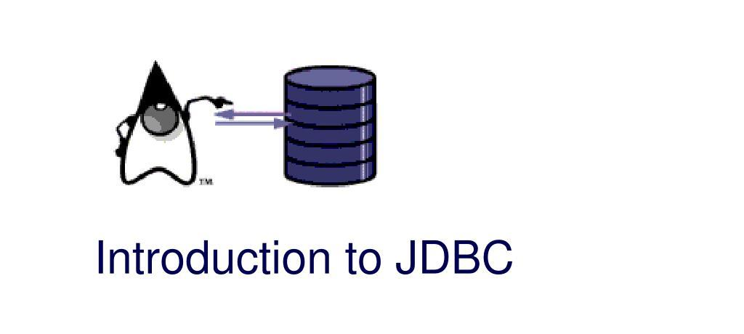
Introduction to JDBC: Bridging Java and Databases
What is JDBC?
JDBC stands for Java Database Connectivity. It is a Java API (Application Programming Interface) that defines how a client can access a database.
JDBC is a standard for connecting Java applications to a wide range of relational databases (e.g., MySQL, Oracle, PostgreSQL, SQL Server).

Slide 9
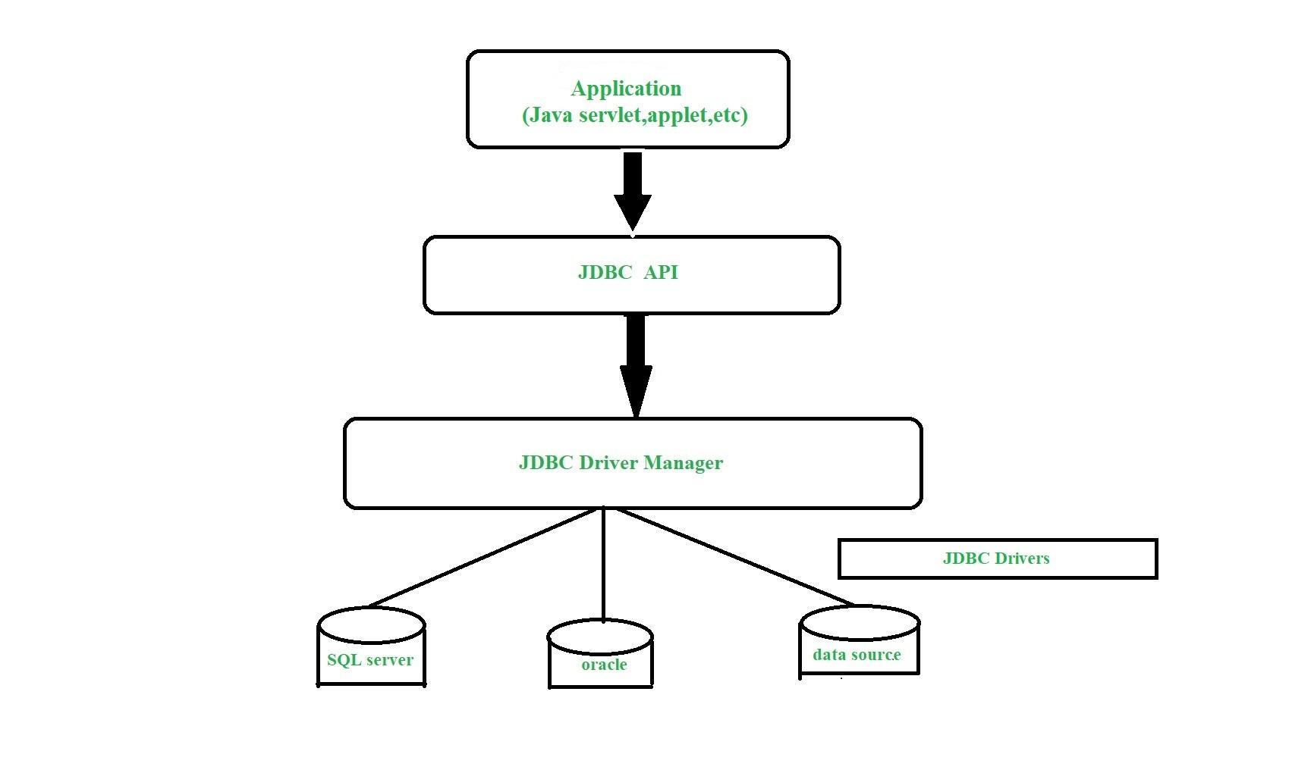
JDBC Architecture: Components and Flow
The JDBC API consists of several key components that work together:
1. **JDBC Driver Manager:** The `DriverManager` class manages a set of JDBC drivers. It's the first point of contact for a Java application when connecting to a database. It selects the appropriate driver for a given connection URL.
2. **JDBC Driver:** A software component that enables the Java application to interact with the database. Different databases require different drivers (e.g., MySQL Connector/J for MySQL).

Slide 10
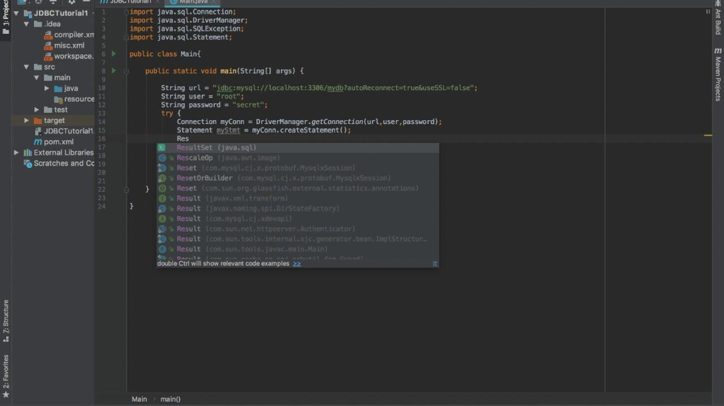
Connecting Java with MySQL Database
To connect your Java application to a MySQL database, you need the MySQL JDBC driver (Connector/J JAR file).
Steps:
1. **Load the Driver:** Inform the Java Virtual Machine (JVM) about the JDBC driver. (Traditionally `Class.forName("com.mysql.cj.jdbc.Driver")`, though often not strictly necessary with modern JDBC drivers and classpath setup).

Slide 11
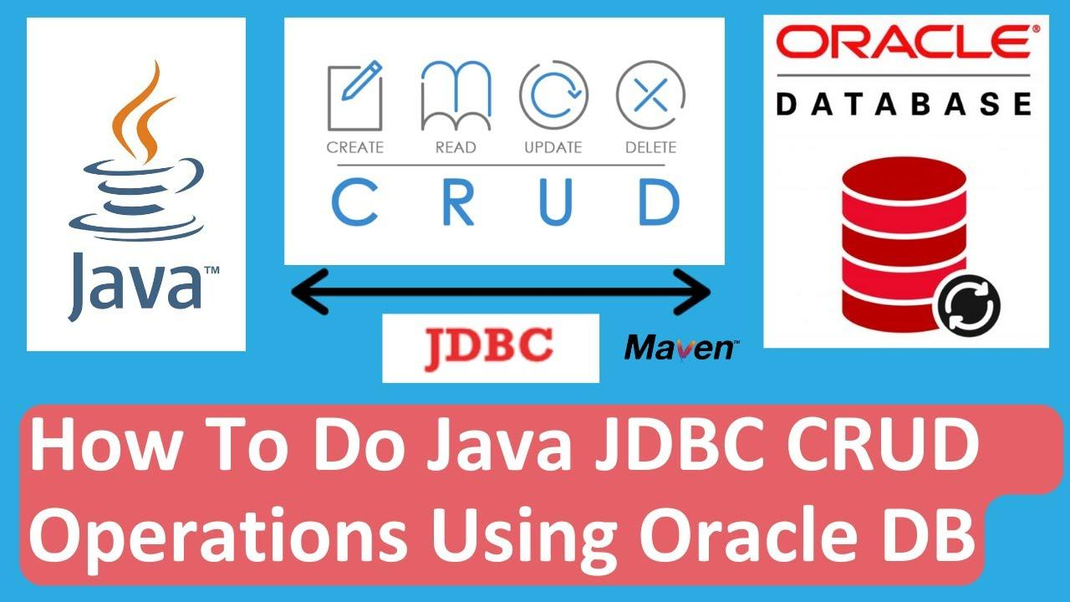
Performing CRUD Operations with JDBC (Part 1)
CRUD stands for Create, Read, Update, and Delete. These are the four basic functions of persistent storage.
Analogy: CRUD as adding, reading, updating, deleting library books.
* **Create (INSERT):** Adding a new book to the library's catalog.

Slide 12
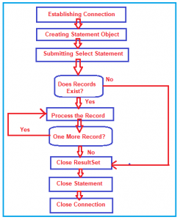
Performing CRUD Operations with JDBC (Part 2)
**3. Update (UPDATE Operation): Updating Book Quantity**
To change the quantity of a specific book in the `Books` table.
SQL Query: `UPDATE Books SET quantity = ? WHERE isbn = ?`

Slide 13
Hands-on & Assignment: Building a Library System
Implement Library Management System:
Your task is to build a console-based or simple GUI Library Management System in Java, integrating both file handling and JDBC for data persistence.

Slide 14

This Photo by Unknown Author is licensed under CC BY-NC

Slide 15


